Slide 1
Summer 18
Summer 19
Summer 20
Blue
Storm
South Twin
Biomass Removed (kg ha⁻¹)
Center
Common Carp
Bigmouth Buffalo
Five Island
75
375
North Twin
50
275
Silver
25
100
10
50

Slide 2
Summer 18
Summer 19
Summer 20
Storm
South Twin
Biomass Removed (kg ha⁻¹)
Center
Common Carp
Bigmouth Buffalo
Five Island
75
375
North Twin
50
275
Silver
25
100
10
50

Slide 3
Summer 18
Summer 19
Summer 20
Blue
REFERENCE
South Twin
Storm
Biomass Removed (kg ha⁻¹)
Center
Common Carp
Bigmouth Buffalo
Five Island
75
375
North Twin
50
275
Silver
25
100
10
50

Slide 4
Summer 18
Summer 19
Summer 20
Biomass Removed (kg ha⁻¹)
Center
Common Carp
Bigmouth Buffalo
Five Island
75
375
North Twin
50
275
Silver
25
100
10
50

Slide 5
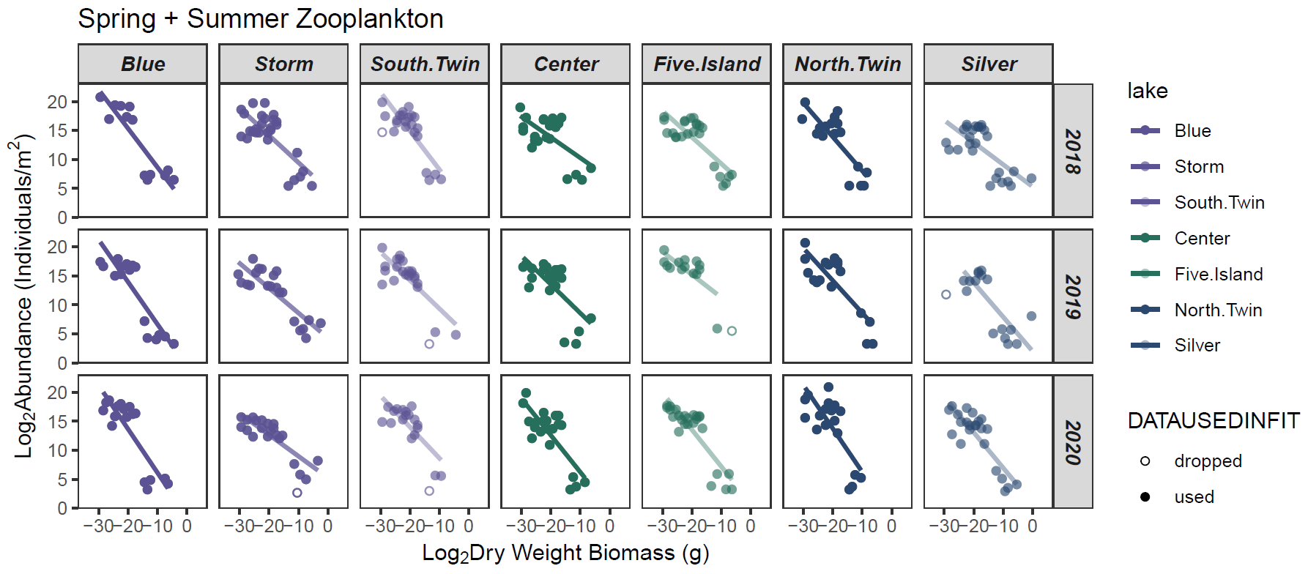

-0.67
-0.47
-0.67
-0.35
-0.46
-0.59
-0.38
-0.73
-0.42
-0.49
-0.49
-0.39
-0.56
-0.59
-0.75
-0.37
-0.54
-0.63
-0.64
-0.75
-0.61

